Slide 1
Algorithm Design II
Jamie Zhang

Slide 2
Review
Write pseudocode to check if a person is eligible to vote. The user should input their age, and the program should output whether they are eligible (age >= 18) or not.
Write pseudocode to check if a year entered by the user is a leap year. A year is a leap year if: It is divisible by 4, but not divisible by 100 unless it is also divisible by 400

Slide 3
Review
Write pseudocode to display the season based on the month number (1 to 12). Use the following mapping:
12, 1, 2: Winter
3, 4, 5: Spring
6, 7, 8: Summer
9, 10, 11: Autumn

Slide 4
Review
Write pseudocode to output from 1 to 20
Write pseudocode to output all the even numbers from 1 to 50
Write pseudocode to ask the users to input a series of data until the data is -1, then output the sum of all the data.
Write pseudocode to output multiplication table

Slide 5
Review
Write pseudocode to output the factorial of a number

Slide 6
Understanding the algorithm
An algorithm sets out the steps to complete a given task.

Slide 7
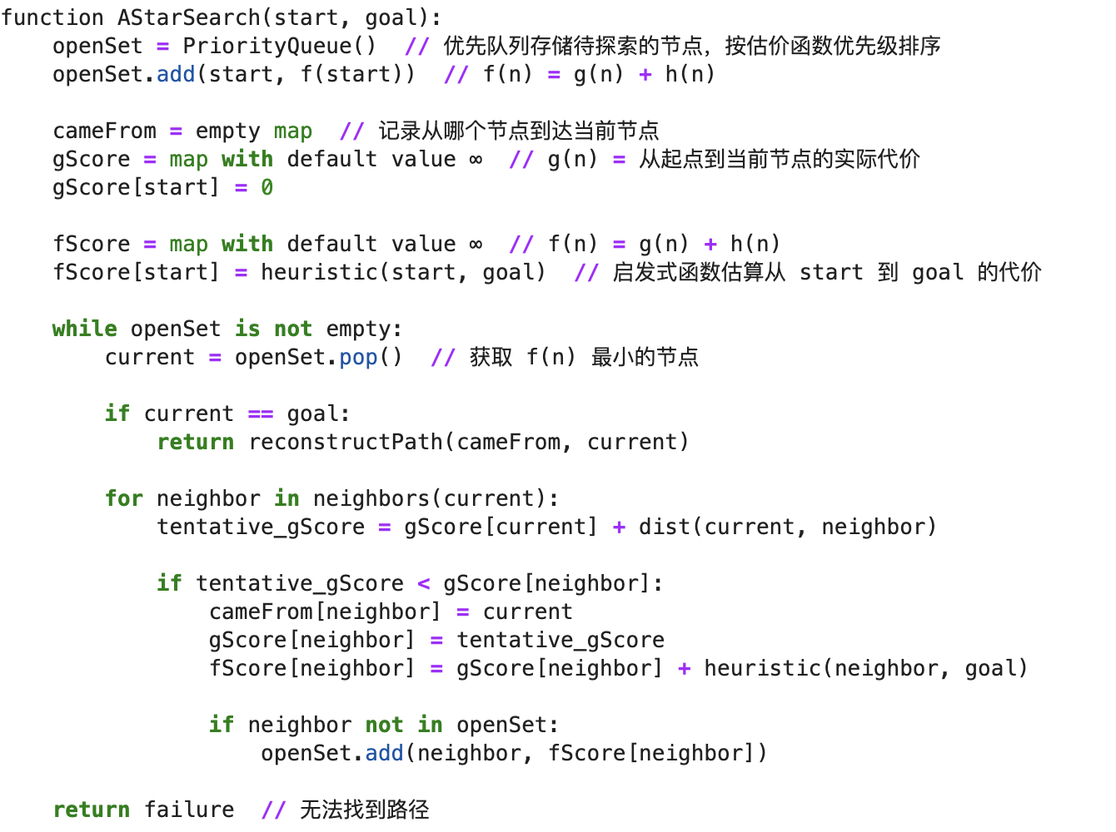
A difficult algorithm

Slide 8
How to read it
Step by step
Combined with the loops/conditional statement framework

Slide 9
What does this algorithm do?
DECLARE Limit : INTEGER
DECLARE Value : REAL
DECLARE Total : REAL
DECLARE Counter : INTEGER
Total <- 0
Limit <- ROUND(RANDOM() * 19, 0) + 1
Counter <- 1
FOR Loop <- 1 TO Limit DO
OUTPUT "Enter a number"
INPUT Value
Total <- Total + Value
END FOR
OUTPUT "The total of the numbers entered is ", Total
OUTPUT "The average of the numbers entered is ", Total / Limit

Slide 10
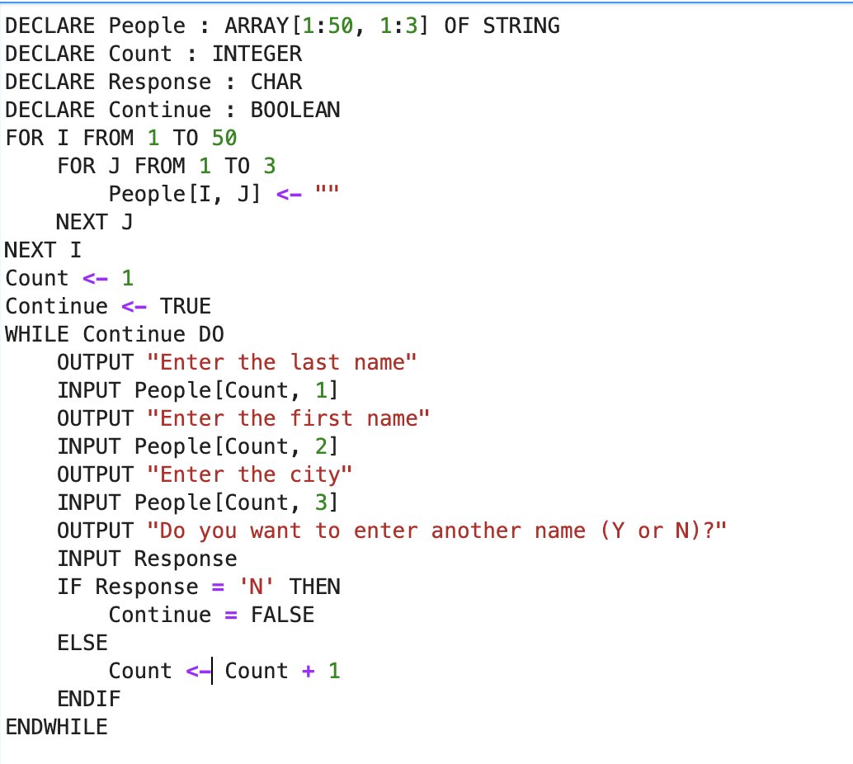
What does this algorithm do?

Slide 11
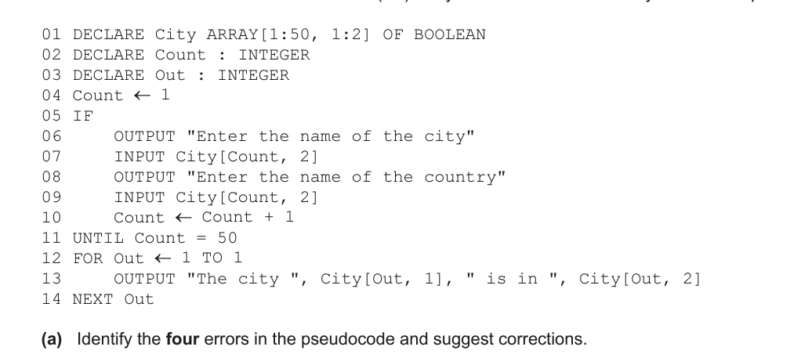
Errors in this algorithm

Slide 12
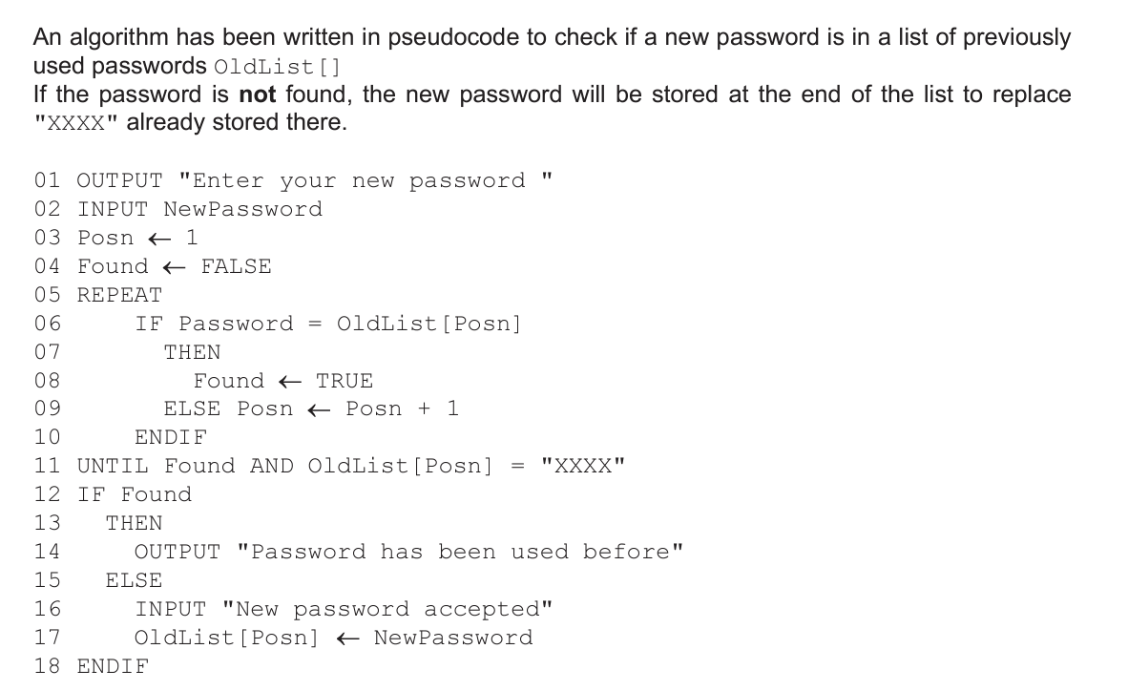
Errors in this algorithm

Slide 13
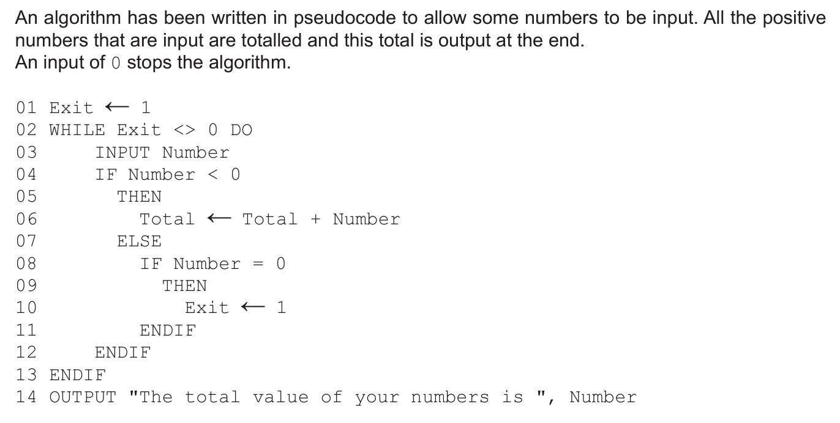
Errors in this algorithm

Slide 14
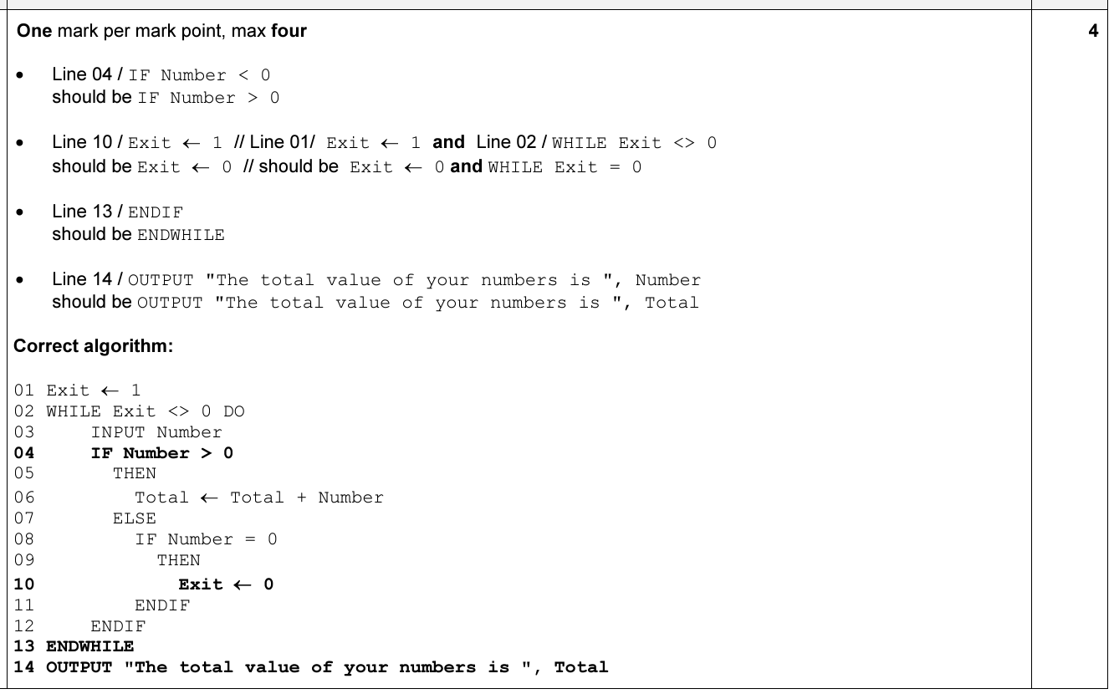
Ans

Slide 15
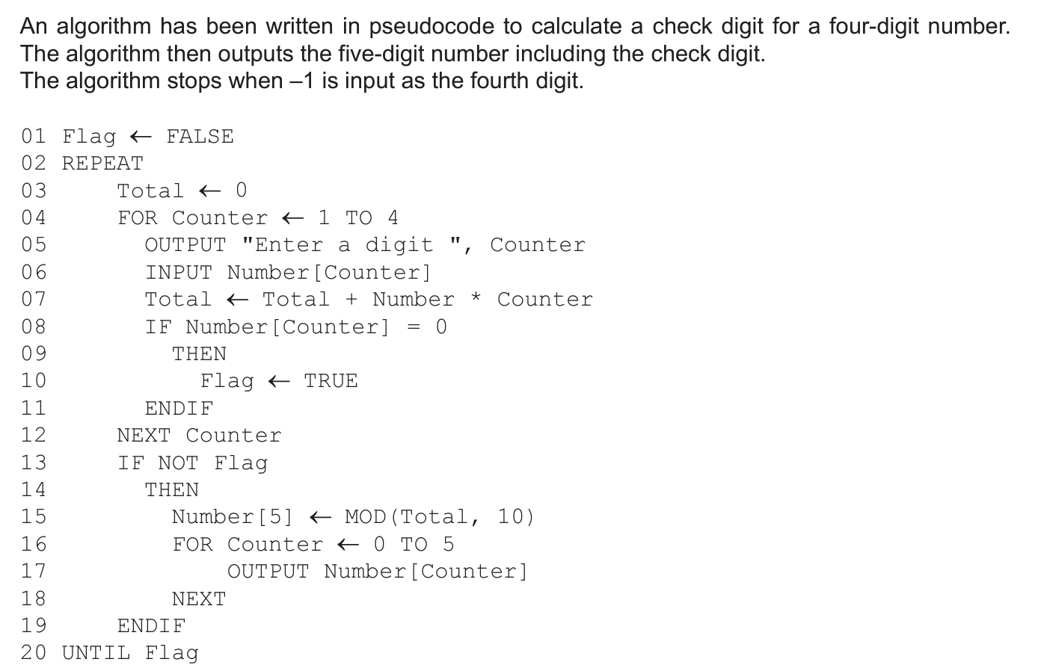
Errors in this algorithm

Slide 16
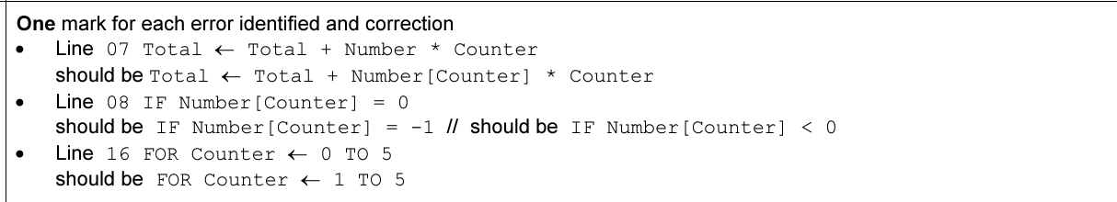
Ans

Slide 17
Totalling
定义一个值来存，给值赋0
循环 每次循环加上那个数组的第i个数
更新i，每次循环+1
直到i长度大于数组长度，循环结束

Slide 18
Totalling
Total ← 0
FOR Counter ← 1 TO ClassSize
Total ← Total + StudentMark[Counter]
NEXT Counter

Slide 19
Totalling
Write pseudocode to calculate the sum of multiple integers entered by the user. Stop accepting input when the user enters -1 or when the number of inputs reaches 100, and then output the sum (-1 is not included in the sum).

Slide 20
Counting
定义一个值来存，
循环 每次循环判断是否满足条件
满足的话在值上+1(-1)
更新i，每次循环+1
直到i长度大于数组长度，循环结束

Slide 21
A very interesting math question
You have two choices to transform a number:
1. Add 1 to the number (+1).
2. Multiply the number by 2
You start with the number 0. What’s the minimum number of steps it takes to transform the number 0 to 293817?

Slide 22
Counting
Write pseudocode to simulate counting stock in a warehouse. The user starts with an initial stock count N, which is a positive integer representing the number of items available. For each iteration, the user can specify the number of items they wish to remove from the stock. The process stops if the stock reaches 0 or if the user inputs -1 to indicate they are done. After each iteration, display the current stock count.

Slide 23
Max/Min/Average
What’s the algorithm?

Slide 24
Max/Min/Average
定义一个变量用于存储最大值
每次循环，判断当前元素是否大于当前存储的最大值。如果是，则将当前元素设为新的最大值。
更新索引 i：
直到 i 超过数组的长度。
循环结束后，输出最大值。

Slide 25
Max/Min/Ave
What’s the initial value of Max/Min? And why?

Slide 26
Average
It’s just one step+totalling!

Slide 27
Max/Min/Average
Write pseudocode to read N integers from the user and determine the maximum and minimum values among them. The number of integers N is entered by the user at the beginning. If N is zero or negative, output an error message indicating that a valid number is required. Otherwise, read the N integers and then output the maximum and minimum values.

Slide 28
Ans to the previous question
1000111101110111001

Slide 29
Boolean
What data types have we talked about?

Slide 30
Arrays
array is a data structure containing several elements of the same data type;these elements can be accessed using the same identifier name. The position of each element in an array is identified using the array’s index.

Slide 31
Linear Search
Loop+conditional statement
It inspects each item in a list in turn to see if the item matches the value searched for.

Slide 32
Linear Search
用一个变量定义是否找到，初始为False（没找到）
遍历数组 查询是否有
如果有 把变量设置成True
最后判断变量的值，如果是True则找到

Slide 33
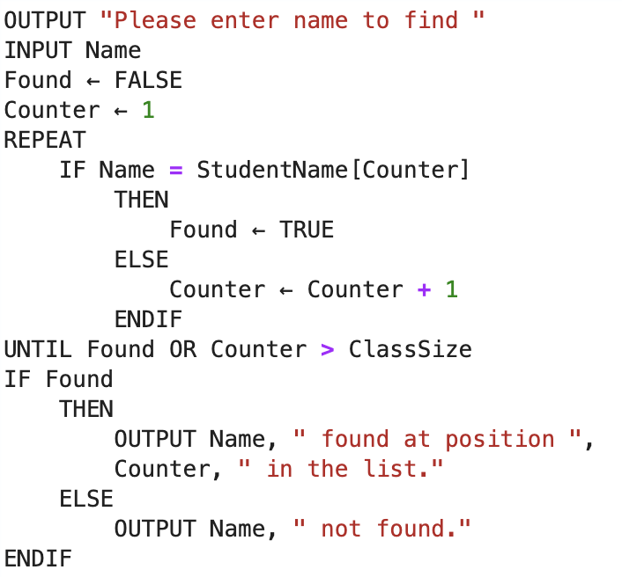
Linear Search

Slide 34
Linear Search
Can I use FOR here?
How to rewrite it in the WHILE format

Slide 35

Bubble Sort
Each element is compared with the next element and swapped if the elements are in the wrong order, starting from the first element and finishing with next-to-last element. Once it reaches the end of the list, we can be sure that the last element is now in the correct place.

Slide 36
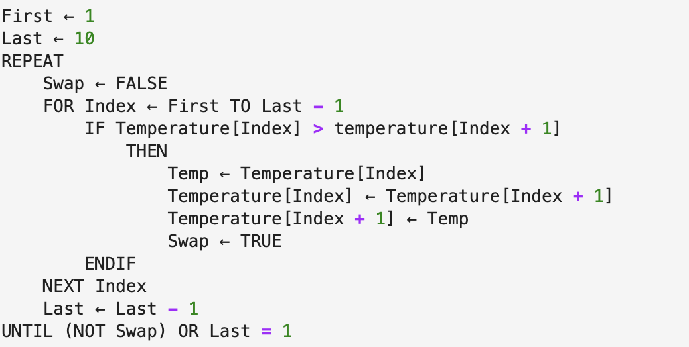
Bubble Sort

Slide 37
Bubble Sort
Can the code run without using the Swap symbol?
What’s the run time of bubble sort in the best and worst conditions?

Slide 38
A little bit more about searching&sorting
Binary Search 二分查找
Insertion Sort 插入排序
Quick Sort 快速排序
Heap Sort 堆排序

Slide 39
Bubble sort
Let’s suppose you have an array with size arraysize, could you write the algorithm of bubble sort to sort it in the descending order?
What if we need to use 2 for loops to write it?

Slide 40
An interesting math-computer questions
You have several piles of stones, you could choose a pile and pick several stones from that pile. And the player who takes the last stone wins.
- Do the first player have a winning strategy?
- Do the second player have a winning strategy?

Slide 41
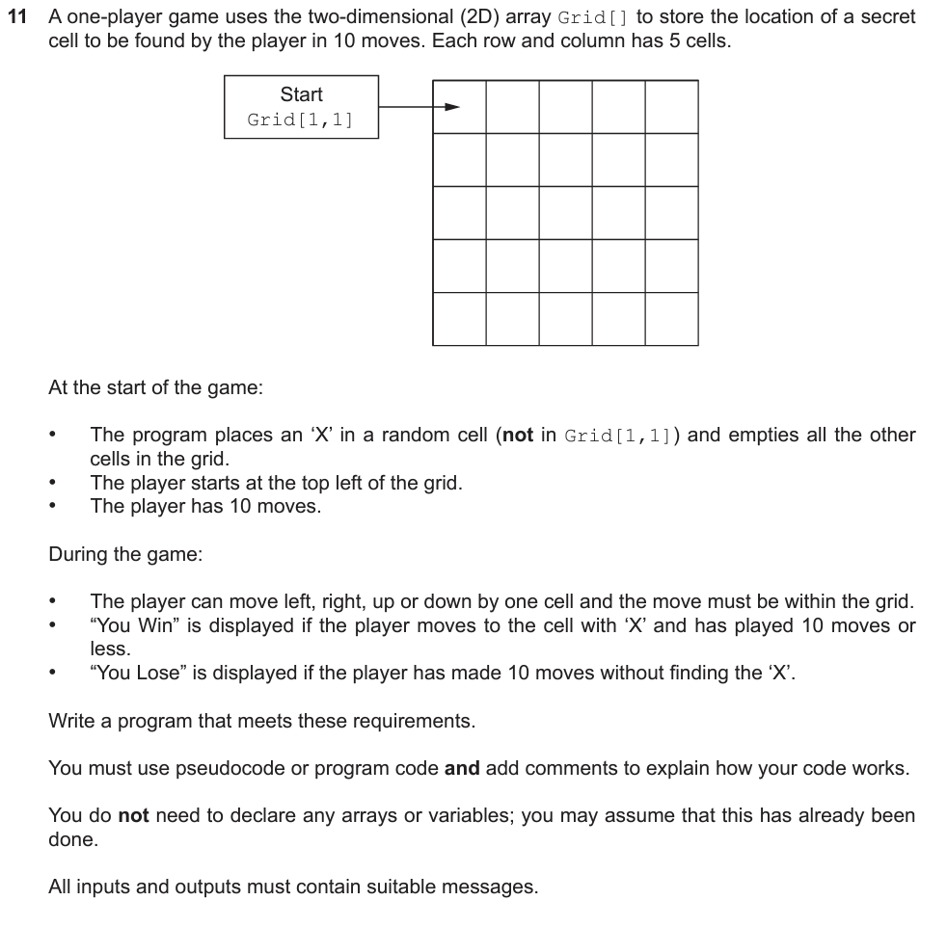
A real exam question

